Slide 1
Thermal Chamber Project-Based Learning
Building LabVIEW Plugins for PAtools

Slide 2
Overview
Required Hardware: PXI Chassis, PXI Controller (8880, 8881, 8882, 8860, 8861, 8862)
Required Software: LabVIEW 2024 Q3 64-bit, PAtools 2025 Q2, Battery Lab Software Plug-In Developer Toolkit 2025 Q2, NI-VISA, Linux RT 2025 Q2
Recommended Prerequisites: PAtools Fundamentals, LabVIEW Core 1 and Core 2
Phase 1: Validate API in simulated environment
Phase 2: Create AMS LabVIEW plugin
Phase 3: Build PAtools device module
Phase 4: Map driver signals to application signals
Note: It is not required to complete the previous phase before proceeding to the next. See the Support folder for starting points of each phase. If starting at a different phase, refer to Phase 1 for setting up the simulated environment.

Slide 3
Resources
All API’s and simulation units are provided in the training repository. Other demo units and the original API can be found on Thermotron’s website.
Thermotron Driver: https://thermotron.com/service-2/instrument-drivers
Thermotron Demo Unit: https://thermotron.com/resources-category/demos
Thermotron Programming Guide: https://thermotron.com/pdf/_service/software-updates/8800-manual.pdf
Git Client: https://www.sourcetreeapp.com
AMS Repository: https://github.com/ni/adas-replay-hil-internal
NI Repository Access Request Form: https://forms.office.com/r/u0mS2zUKdg
TCP Traces in Linux: https://linuxize.com/post/tcpdump-command-in-linux
Wireshark Tool: https://www.wireshark.org

Slide 4
Phase 1: Validate API
Objective: In this phase, you will setup the simulated thermal chamber and validate the LabVIEW API provided with this training.

Slide 5
Phase 1: Connections
PC
LabVIEW
Chamber

Slide 6
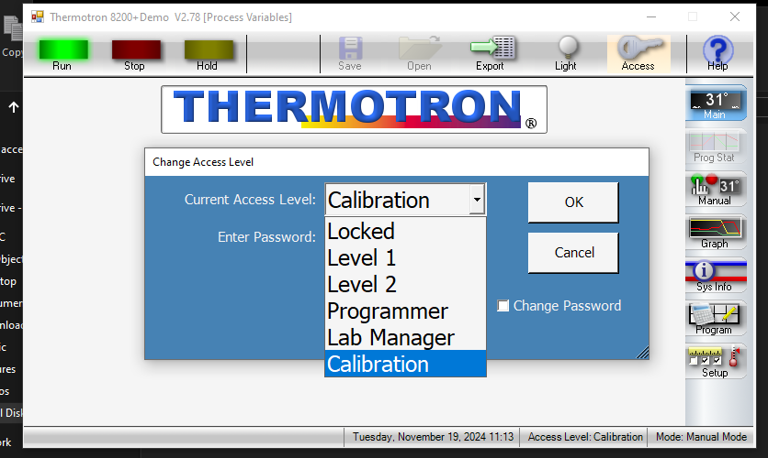
Phase 1: Setup Simulated Environment
Install Thermotron 8200+ demo unit located in the repository: C:\...\thermal-chamber-pbl\Support\Simulated Chamber Installation\8200Demo.zip
Set the access level to Calibration for full control of the demo unit

Slide 7
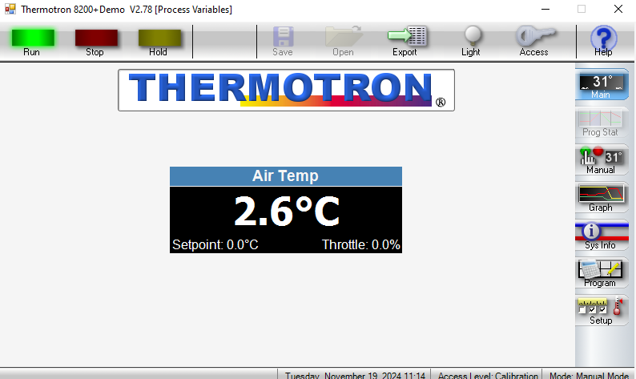
Phase 1: Setup Simulated Environment
Using the Manual mode, ensure that the start and stop operate as expected

Slide 8
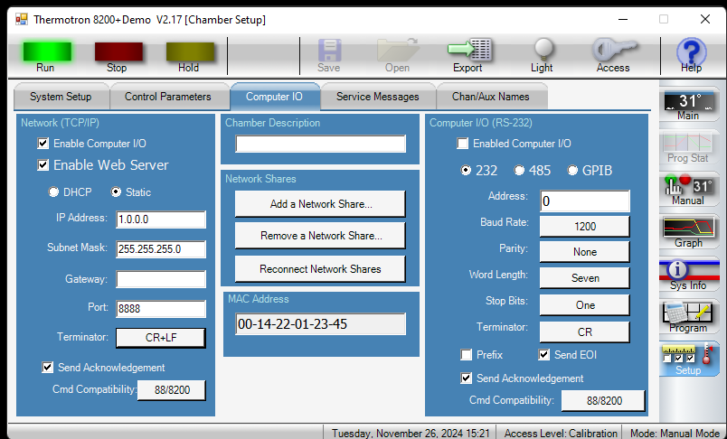
Phase 1: Setup Simulated Environment
For initial setup, you will use the loopback 127.0.0.1 IP address, so setting the IP address for on the 8200 is not critical
Terminator must be set to CR+LF for compatibility with the provided API
The TCP/IP connection mode is used for this training

Slide 9
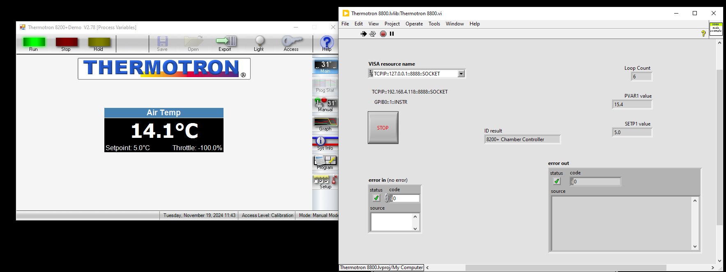
Phase 1: Validate API in Simulated Environment
Open the LabVIEW API provided with this training: C:\...\thermal-chamber-pbl\Support\LabVIEW API\Thermotron8800InstrumentDriver64bitForLabView2018\Thermotron 8800\Thermotron8800.lvproj
Set VISA resource to TCPIP::127.0.0.1::8888::SOCKET to point to the local computer
Run the example VI and confirm that feedback and temperature commands execute without error

Slide 10
Phase 2: Create LabVIEW AMS Project
Objective: In this phase, you will create the AMS driver and implement all plugin functionality.

Slide 11
Phase 2: Connections
PXI
PC
LabVIEW Plugin
Chamber

Slide 12
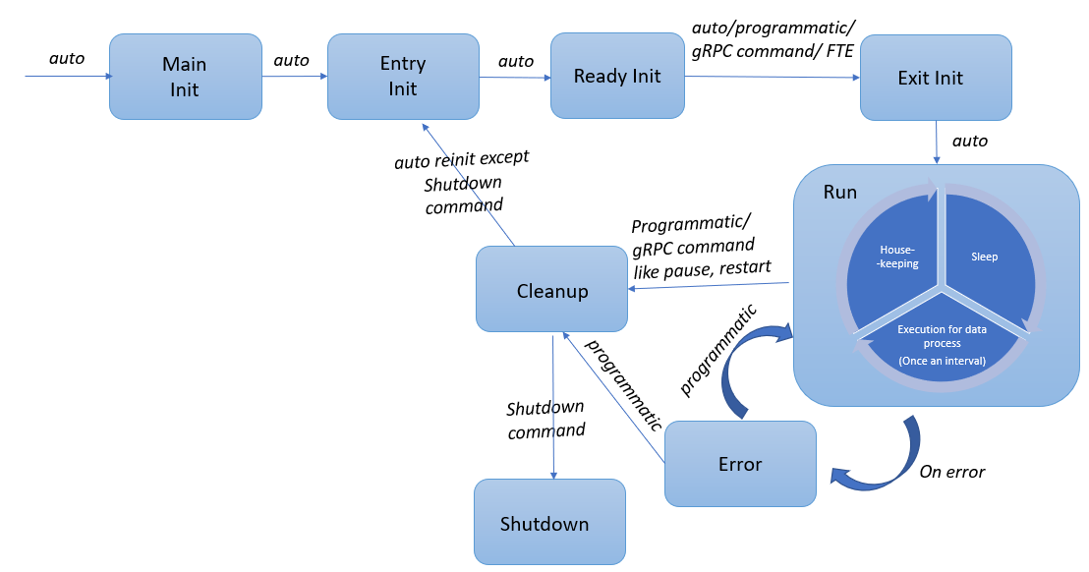
Phase 2: Asynchronous Micro-Service (AMS) Overview
Extensive training documentation can be found in the adas-replay-hil wiki
AMS is a tag-based architecture for building reusable plugins across various software platforms: LabVIEW, VeriStand, TestStand, and PAtools
There are two primary ways to interface with the plugin
Tag Channels: inputs and outputs (on/off, temperature setpoint/feedback)
Configuration Parameters: static values not updated at runtime (IP address)
There are three primary states we will configure
Exit Initialize: establish TCP connection, initialize chamber, set chamber to ready-to-operate
Process Data: read temperature feedback and status, set temperature setpoint
Cleanup: set chamber to safe state, close TCP connection

Slide 13
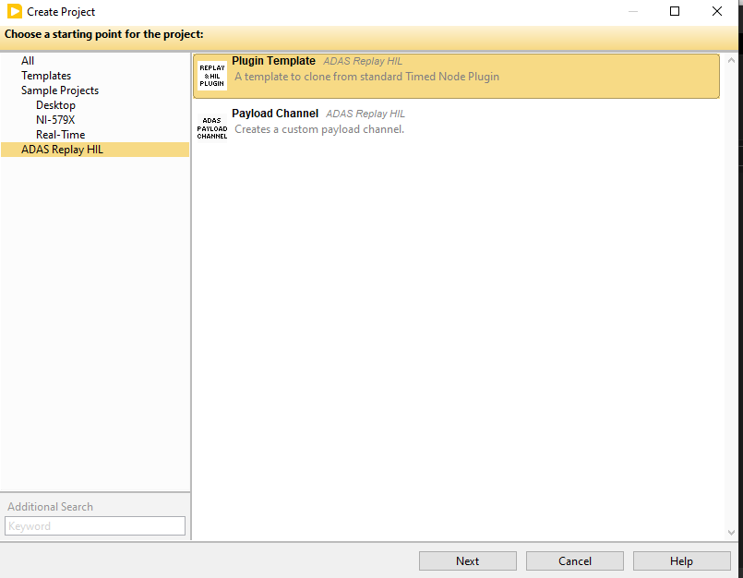
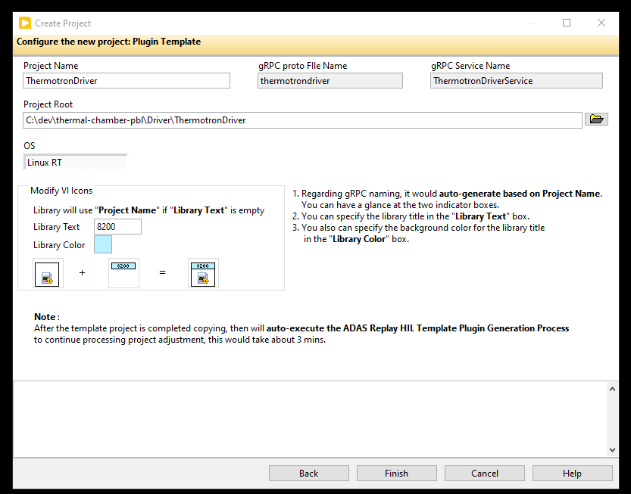
Phase 2: Create Project
Open LabVIEW and select Create Project
Select ADAS Replay HIL and Plugin Template
Configure the project as shown below

Slide 14
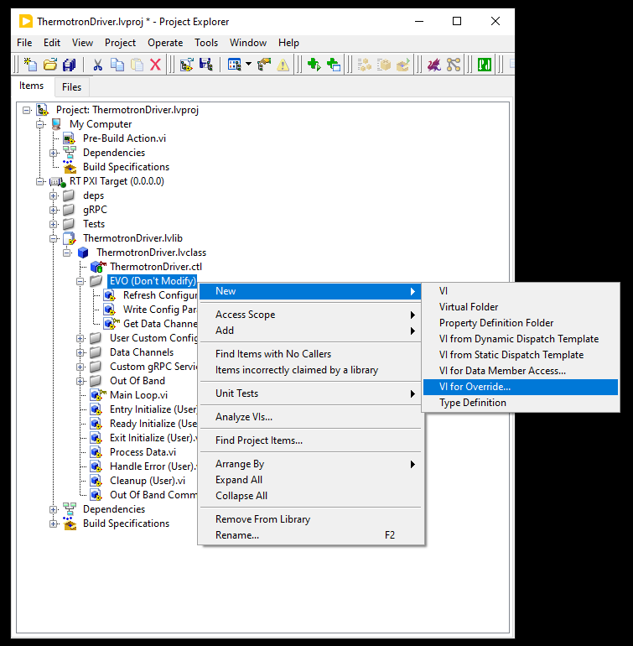
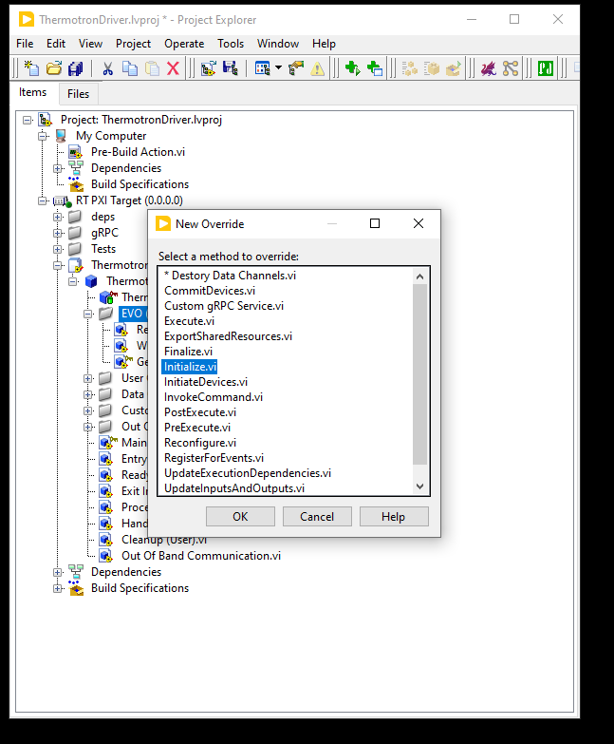
Phase 2: Add Initialize Override
An override for the AMS initialization sequence is needed to synchronize the LabVIEW channels using PAtools
Under the ThermotronDriver.lvlib => EVO (Don’t Modify), select VI For Override and select Initialize.vi

Slide 15
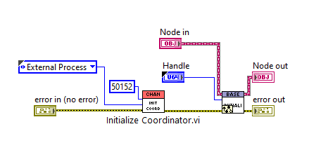
Phase 2: Add Initialize Override
Needed for LabVIEW/PAtools channel synchronization
Add the Initialize Coordinator.vi using the shown parameters

Slide 16
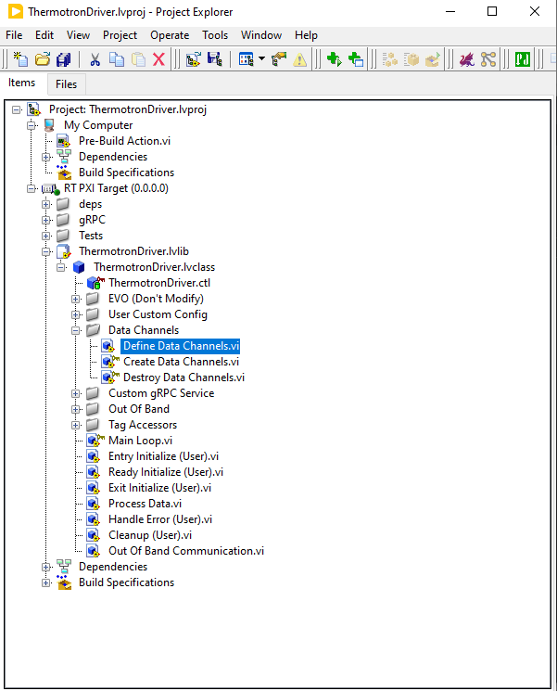
Phase 2: Data Channels Overview
The plugin interfaces with the PAtools application via data channels
Using the standard architecture, there are three necessary actions for configuring the channels
Define Data Channels: defines all input and output channels to be used by the plugin
Create Data Channels: creates all data channels configured in Define Data Channels and stores the tag references to be used throughout execution
Destroy Data Channels: close all data channels at the end of execution

Slide 17
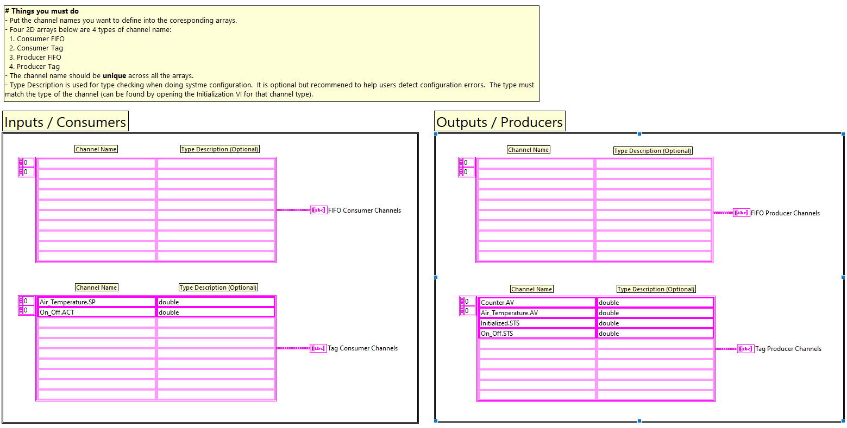
Phase 2: Define Data Channels
All channels must be defined using the Define Data Channels.vi
Configure the data channel names as shown

Slide 18
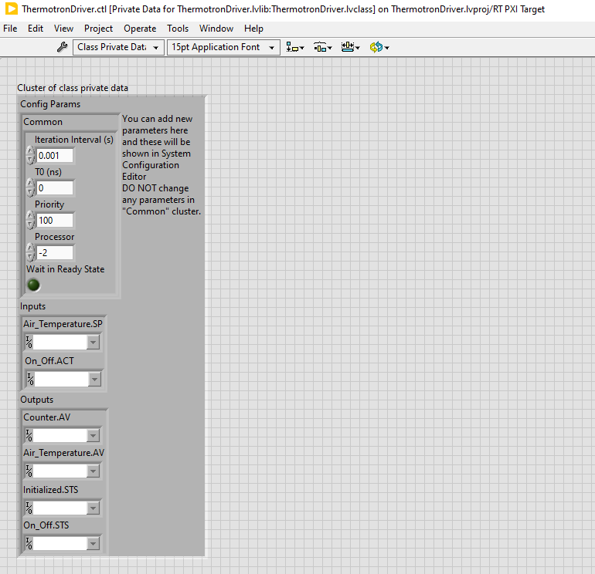
Phase 2: Create Channel Tag References
Add tag references for all inputs and outputs to be used through the plugin execution
The tag references are stored in the private class data

Slide 19
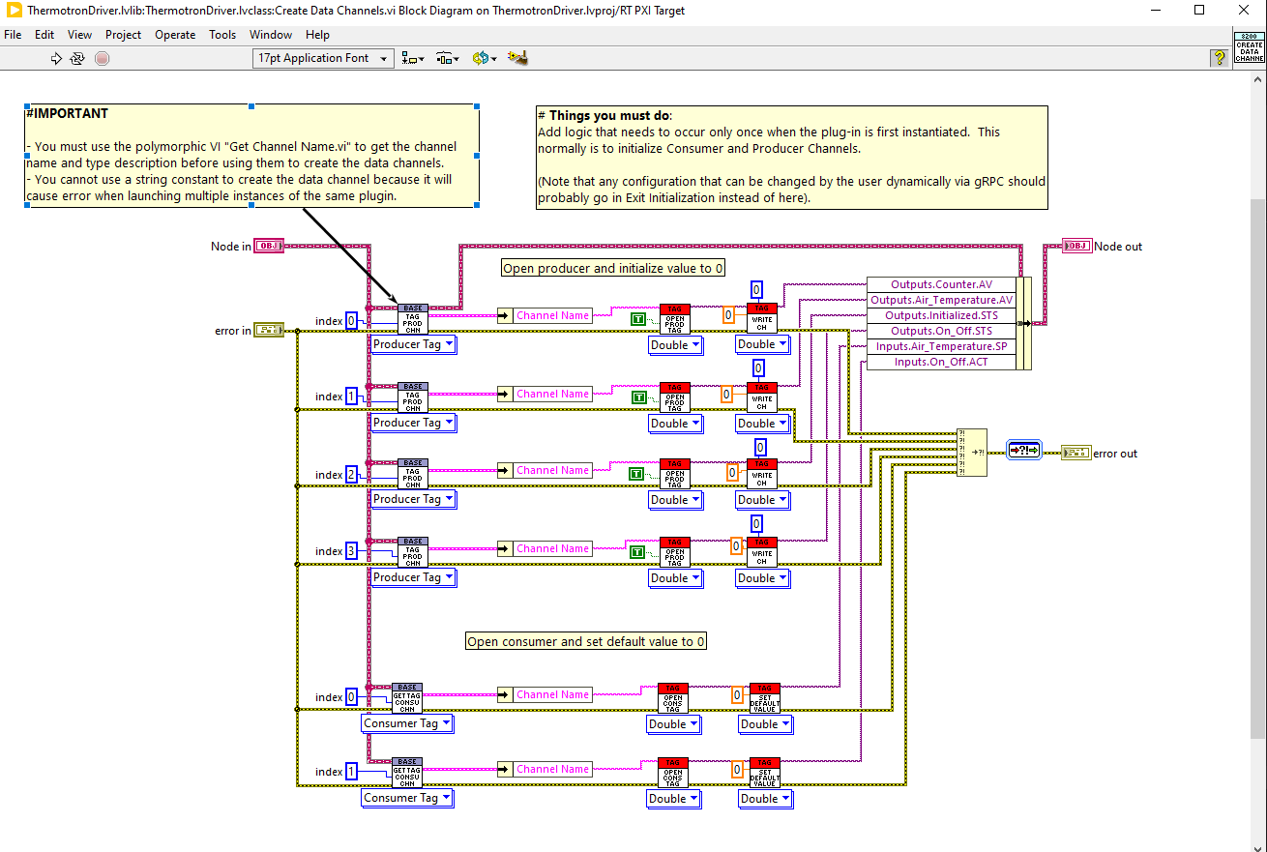
Phase 2: Create Data Channels
In the Create Data Channels.vi, create all data channels using the Tag API and store tag references in the class data
For producers, initially write a value of 0 to avoid execution errors
For consumers, set a default value of 0

Slide 20
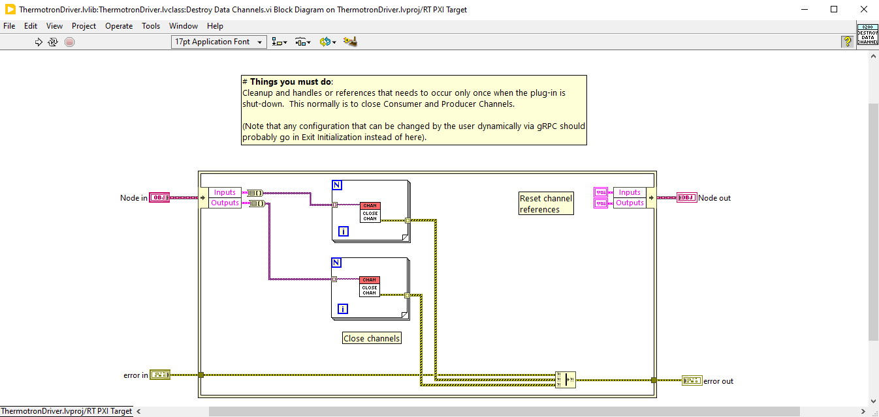
Phase 2: Destroy Data Channels
All tag references must be closed in the Destroy Data Channels.vi

Slide 21
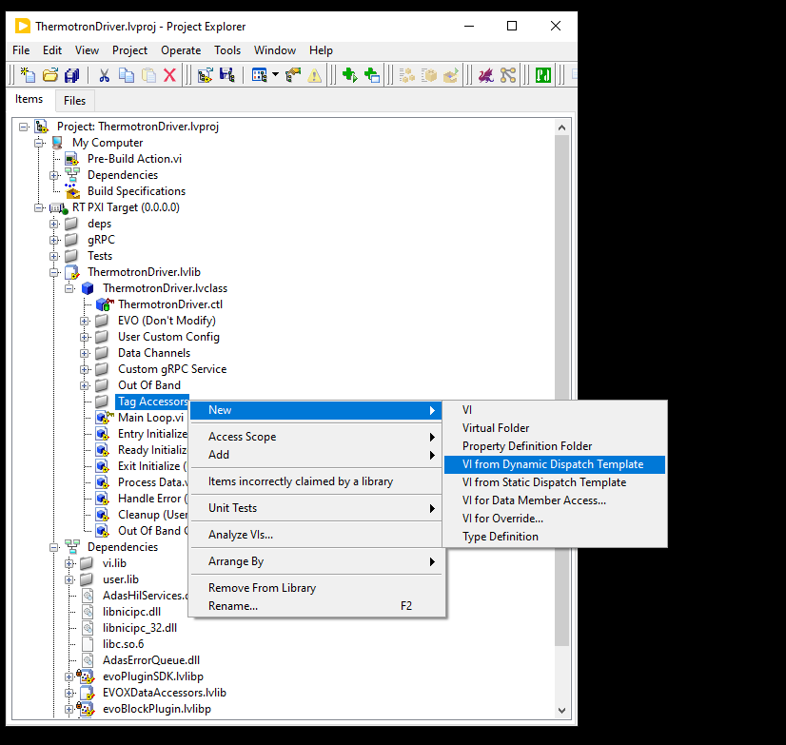
Phase 2: Create Tag Accessors
For code readability, create data accessors for each of the channels
Create a Virtual Folder and select new VI from Dynamic Dispatch Template

Slide 22
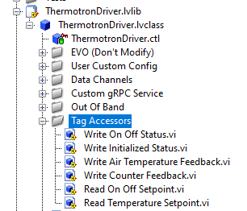
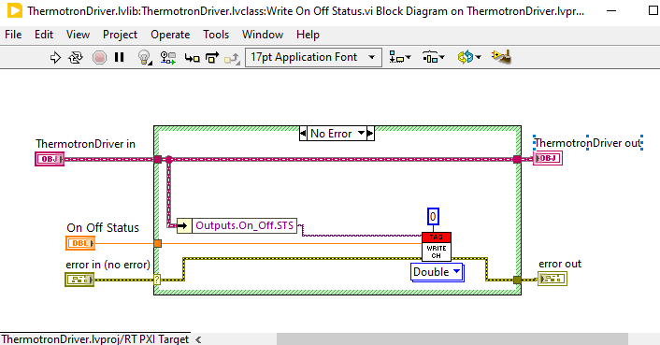
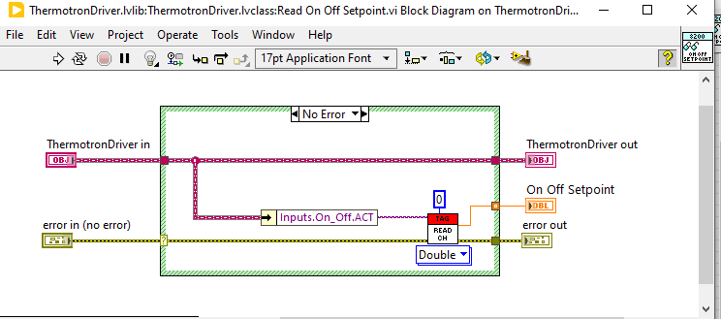
Phase 2: Create Tag Accessors
For each of the inputs and outputs, configure a data accessor as shown below
Ensure to update all terminals and icons
Set inputs terminals to be required

Slide 23
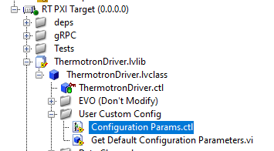
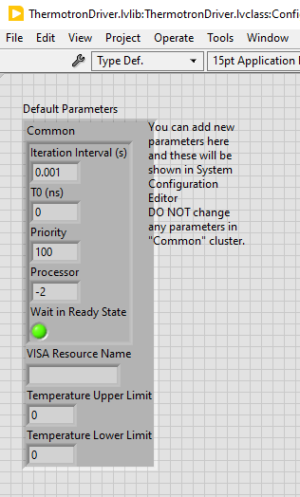
Phase 2: Setup Configuration Parameters
Use Configuration Parameters for any item that is static throughout execution and should be defined pre-runtime
Add a string input for the VISA Resource Name
Note: A string input is used instead of a VISA type because the configuration parameters are set with a JSON string. VISA references are not handled correctly in JSON format.
Add two doubles for the Temperature Upper Limit and Temperature Lower Limit

Slide 24
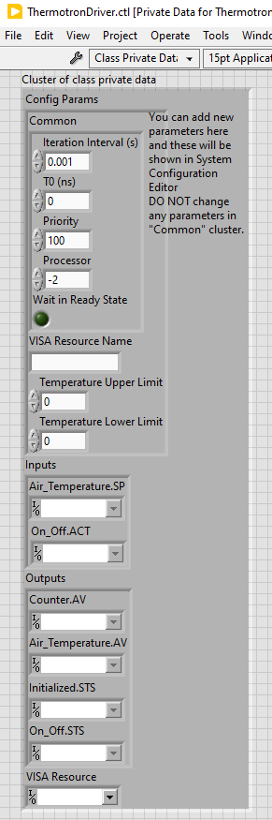
Phase 2: Add VISA Reference to Class Data
For use during execution, add a VISA Resource control to the plugin class data

Slide 25
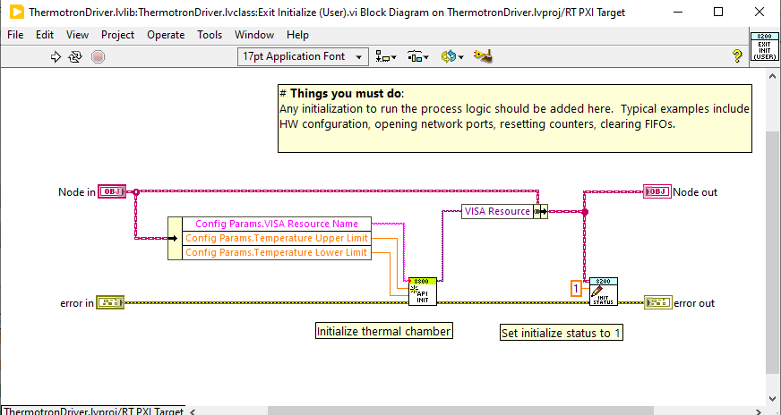
Phase 2: Configure Initialization
The thermal chamber is set to a ready-to-control state in Exit Initialize
Use the API provided in the Support folder: C:\...\thermal-chamber-pbl\Support\LabVIEW API\Thermotron8800InstrumentDriver64bitForLabView2018\Thermotron8800\Thermotron 8800.lvlib
Use the following sub VIs
API Initialize.vi
Write Initialized Status.vi

Slide 26
Phase 2: Configure Process Data
The following Sub VIs are used in Process Data
Write Counter Feedback.vi
Write Air Temperature Feedback.vi
Read On Off Setpoint.vi
Write On Off Setpoint.vi
Read Air Temperature Setpoint.vi
GetLastErrorCode.vi
GetProcessVariable.vi
API Set Run.vi
API Set Stop.vi

Slide 27
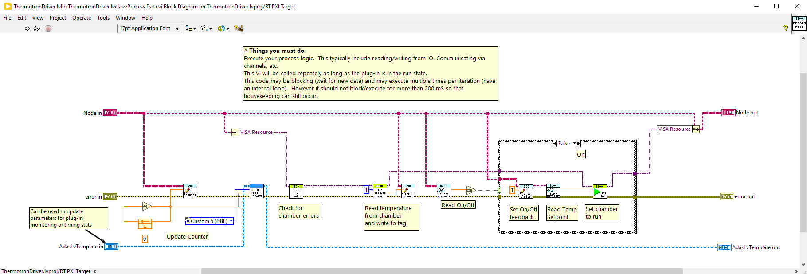
Phase 2: Configure Process Data
In Process Data, you should update the counter, check the chamber status, read the temperature from the chamber and publish to the temperature feedback tag, and read the temperature setpoint tag and write to the chamber setpoint API

Slide 28
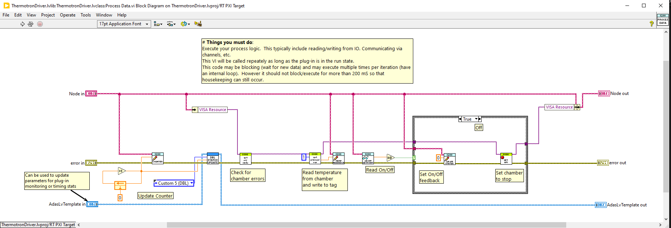

Phase 2: Configure Process Data Off Case

Slide 29
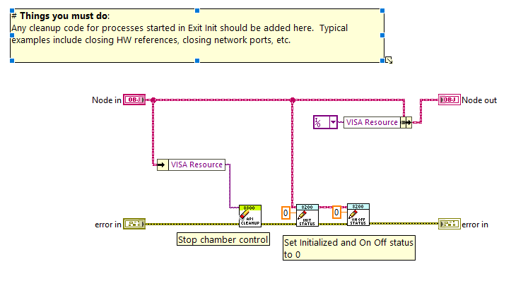
Phase 2: Configure Cleanup
The following Sub VIs are used in Cleanup
API Cleanup.vi
Write initialized Status.vi
Write On Off Status.vi

Slide 30
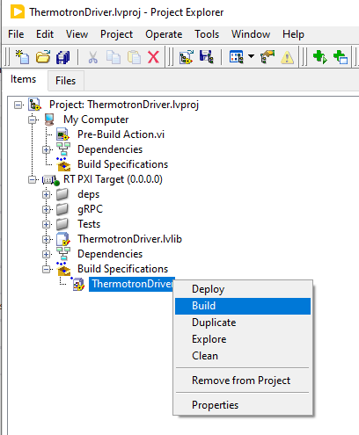
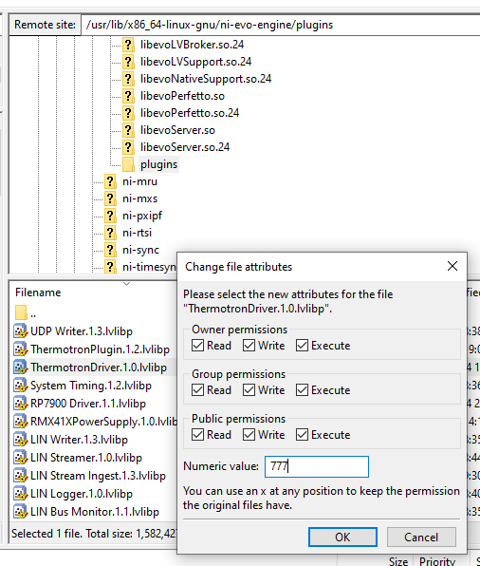
Phase 2: Build Plugin and Test Using gRPC Client
Build the plugin using the default Build Specification
Move to PXI using FileZilla/WinSCP/other SFTP client: /usr/lib/x86_64-linux-gnu/ni-evo-engine/plugins
Set file permissions to 777
Reboot PXI or ssh into PXI and run the following command: enable-adas-startup.sh
This will restart the plugin engine
Note: Do not run this command while plugins are executing

Slide 31
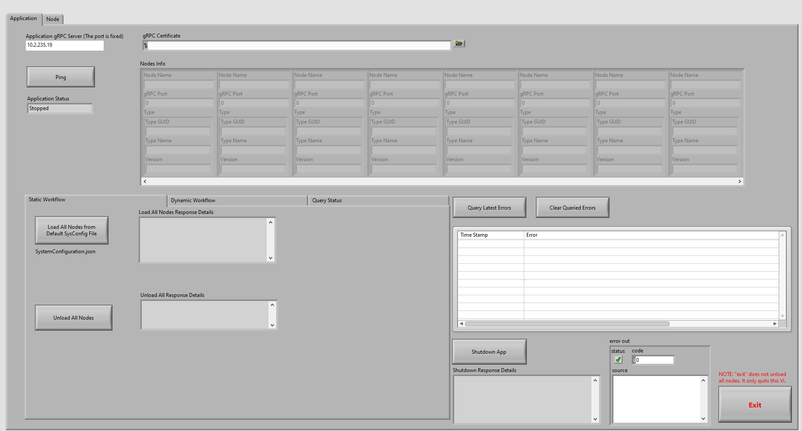
Phase 2: Test Plugin Execution in Example gRPC Client
C:\Program Files\National Instruments\ADAS Replay HIL\App\Example gRPC Client\Example gRPC Client.VI
Enter IP address of PXI and run VI
Confirm you can Ping the PXI using Ping button, Application Status should show Stopped

Slide 32
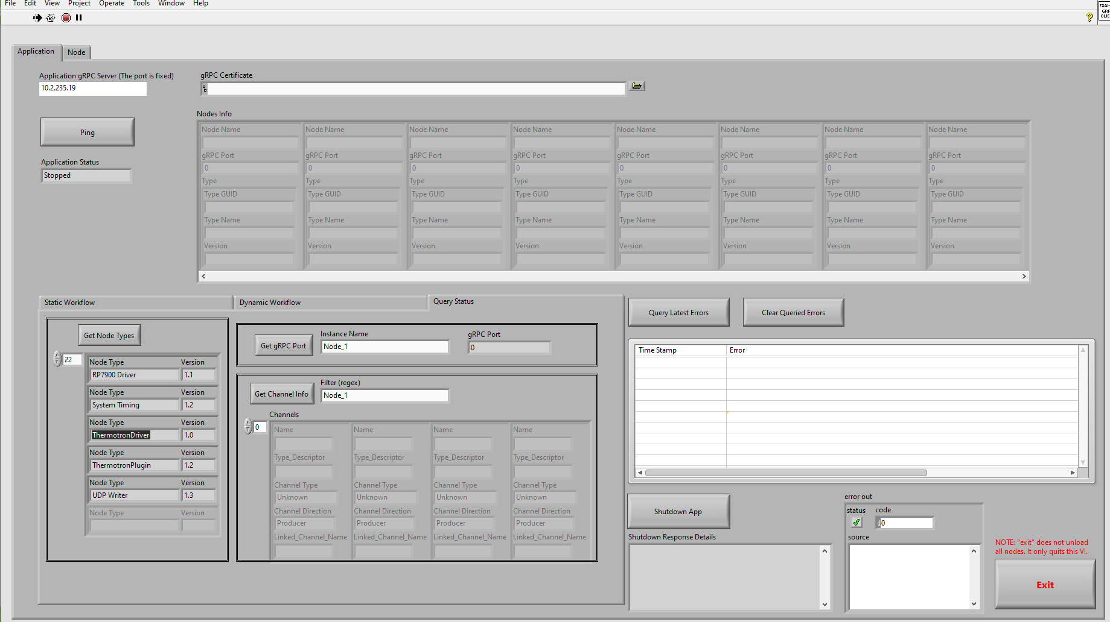
Phase 2: Test Plugin Execution in Example gRPC Client
Click Get Node Types to view all plugins available confirm ThermotronDriver is available

Slide 33
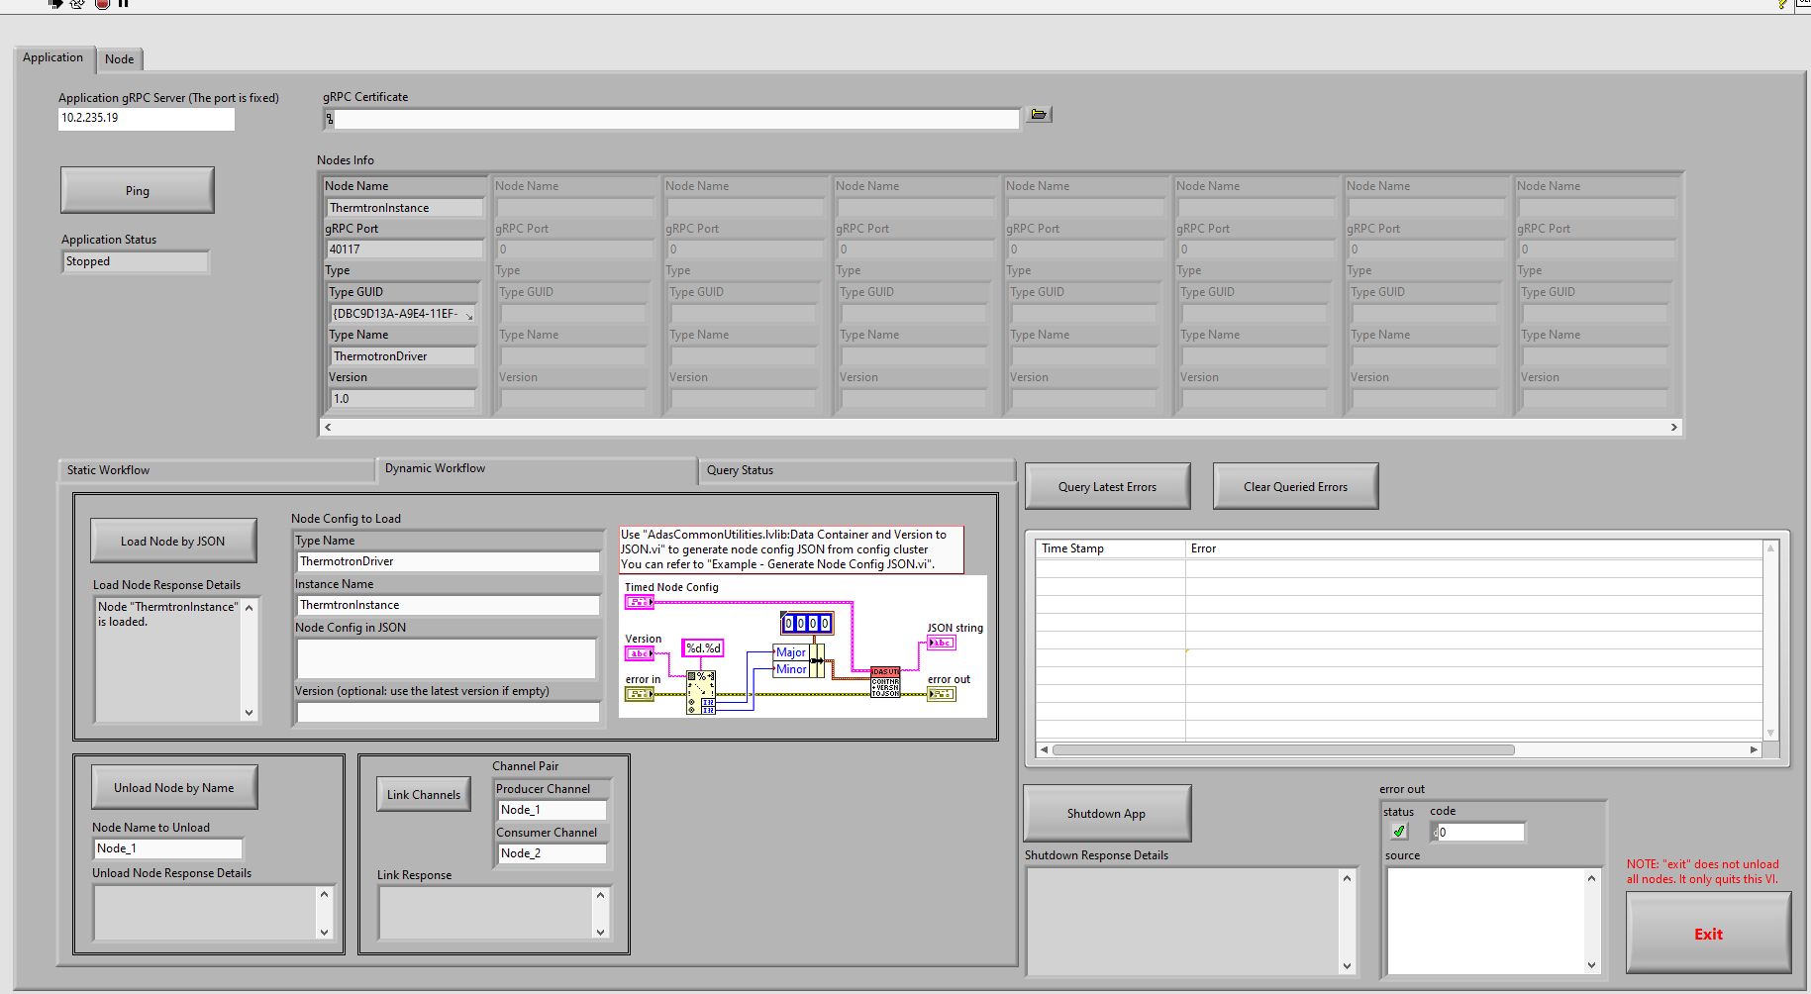
Phase 2: Test Plugin Execution in Example gRPC Client
Using Dynamic Workflow, enter the following options. Node Config in JSON is not needed for this initial test
Confirm that Plugin is loaded, should be in idle state

Slide 34
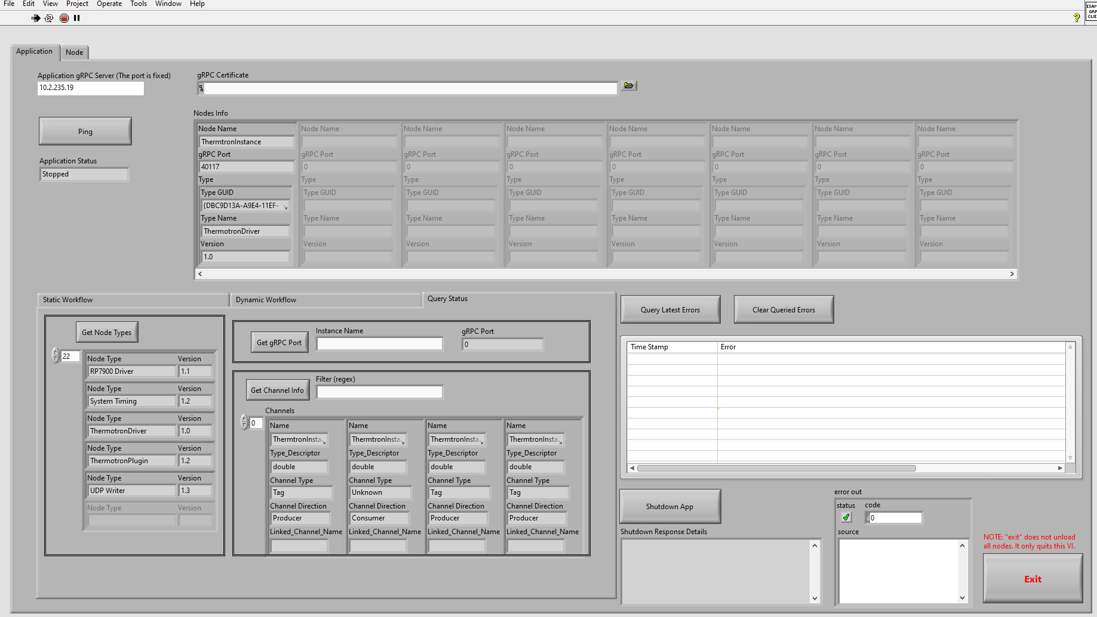
Phase 2: Test Plugin Execution in Example gRPC Client
Under Query Status, clear the Filter and confirm that all channels are created as expected
Unload plugin and confirm that all channels are closed: Navigate to Static Workflow and select Unload All Nodes

Slide 35
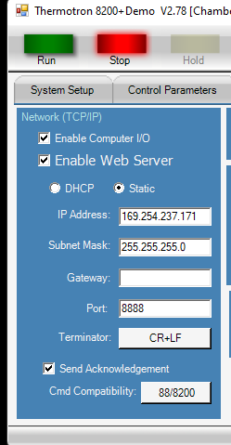
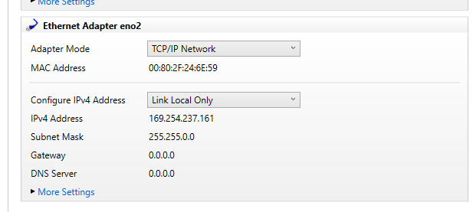
Phase 2: Confirm Communication With Device
Setup IP address for the chamber and the PXI to be on the same subnet
You can either setup the simulated thermal chamber to be on the same network as the PXI or connect the chamber to the second PXI port

Slide 36
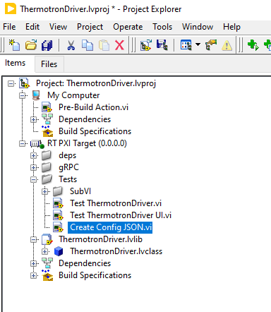
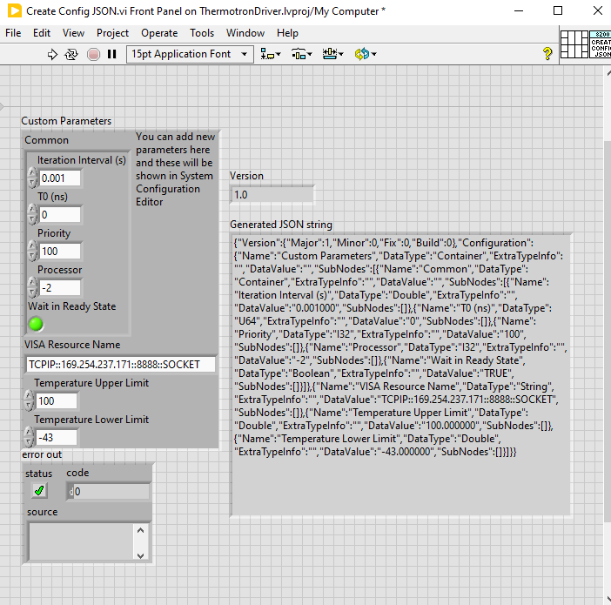
Phase 2: Generate JSON Configuration
Move Create Config JSON.vi to the Windows target (My Computer)
Set limits and enter resource
VISA Resource Format: TCPIP::169.254.237.171::8888::SOCKET
Copy this generated string to Notepad - this JSON configuration will be used in the gRPC Client and PAtools device module
Move Create Config JSON.vi back to the RT target under Tests folder

Slide 37
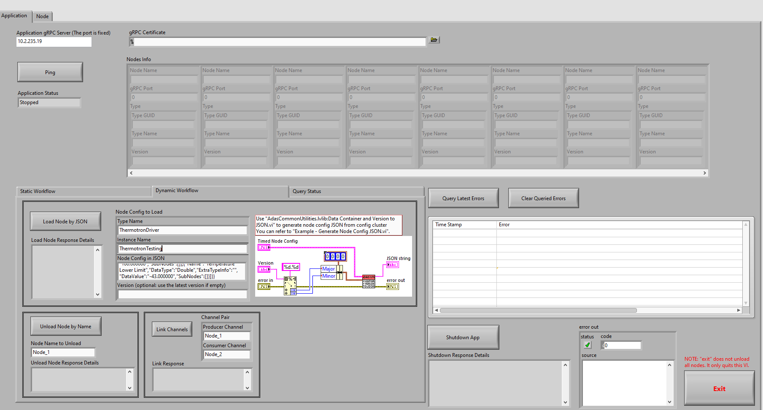
Phase 2: Run Plugin in gRPC Client
Paste JSON config into the Node Config in JSON
Load plugin
Go to Node tab and select Refresh Node Status. You should see the ThermotronTesting in the Ready state

Slide 38
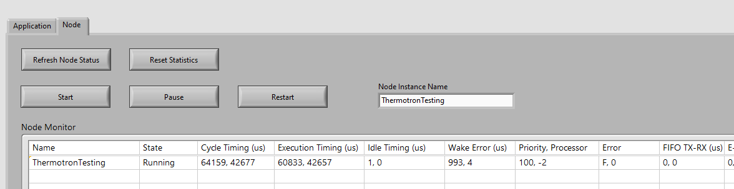
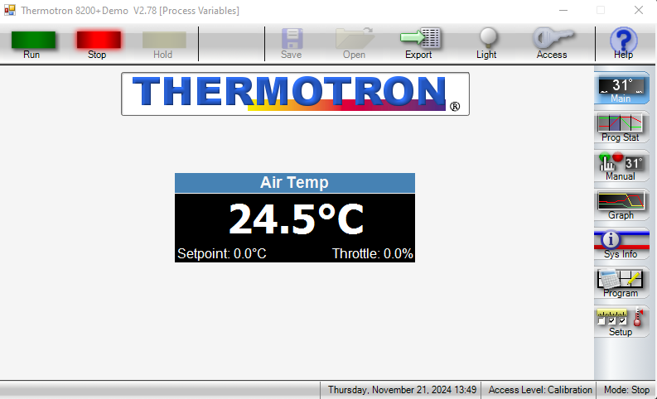
Phase 2: Run Plugin in gRPC Client
Select node and click Start. Click Refresh Node Status and confirm no errors occur and plugin is in the running state
Also confirm that the chamber goes into the manual mode in the Stop state
Unload the plugin

Slide 39
Phase 3: Build PAtools Device Module
Objective: In this phase, build a PAtools device module to call the previously created LabVIEW plugin.

Slide 40
Phase 3: Starting Point
Use the following instructions if you did not complete the previous phases:
Use the prebuilt LabVIEW plugin provided in C:\…\thermal-chamber-pbl\Support\Phase 3 Starting Point
Refer to the JSON configuration TXT file, be sure to input the IP address of the thermal chamber in the JSON configuration string
Move the LabVIEW .lvlibp to PXI using FileZilla/WinSCP/other SFTP client: /usr/lib/x86_64-linux-gnu/ni-evo-engine/plugins
Set file permissions to 777
Reboot PXI or ssh into PXI and run the following command: enable-adas-startup.sh
This will restart the plugin engine
Note: Do not run this command while plugins are executing

Slide 41
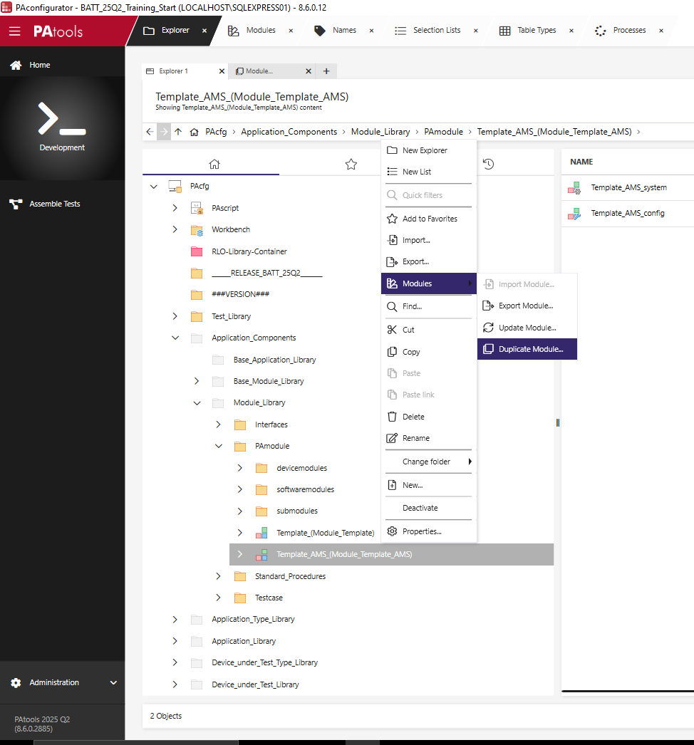
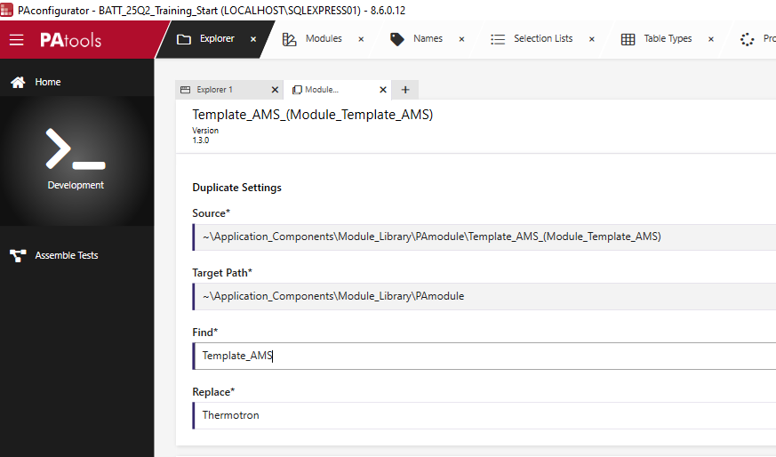
Phase 3: Duplicate Template AMS Module

Slide 42
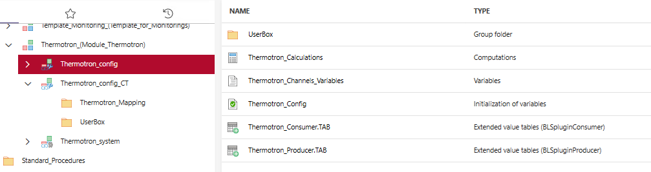
Phase 3: PAtools Device Module Overview
There are 4 main components needed for interfacing with the LabVIEW plugin
Channels Variables: defines all variables used
Consumer Table: defines the consumer channels
Producer Table: defines the producer channels
Config: defines which plugin is used and the configuration parameters using the JSON string

Slide 43
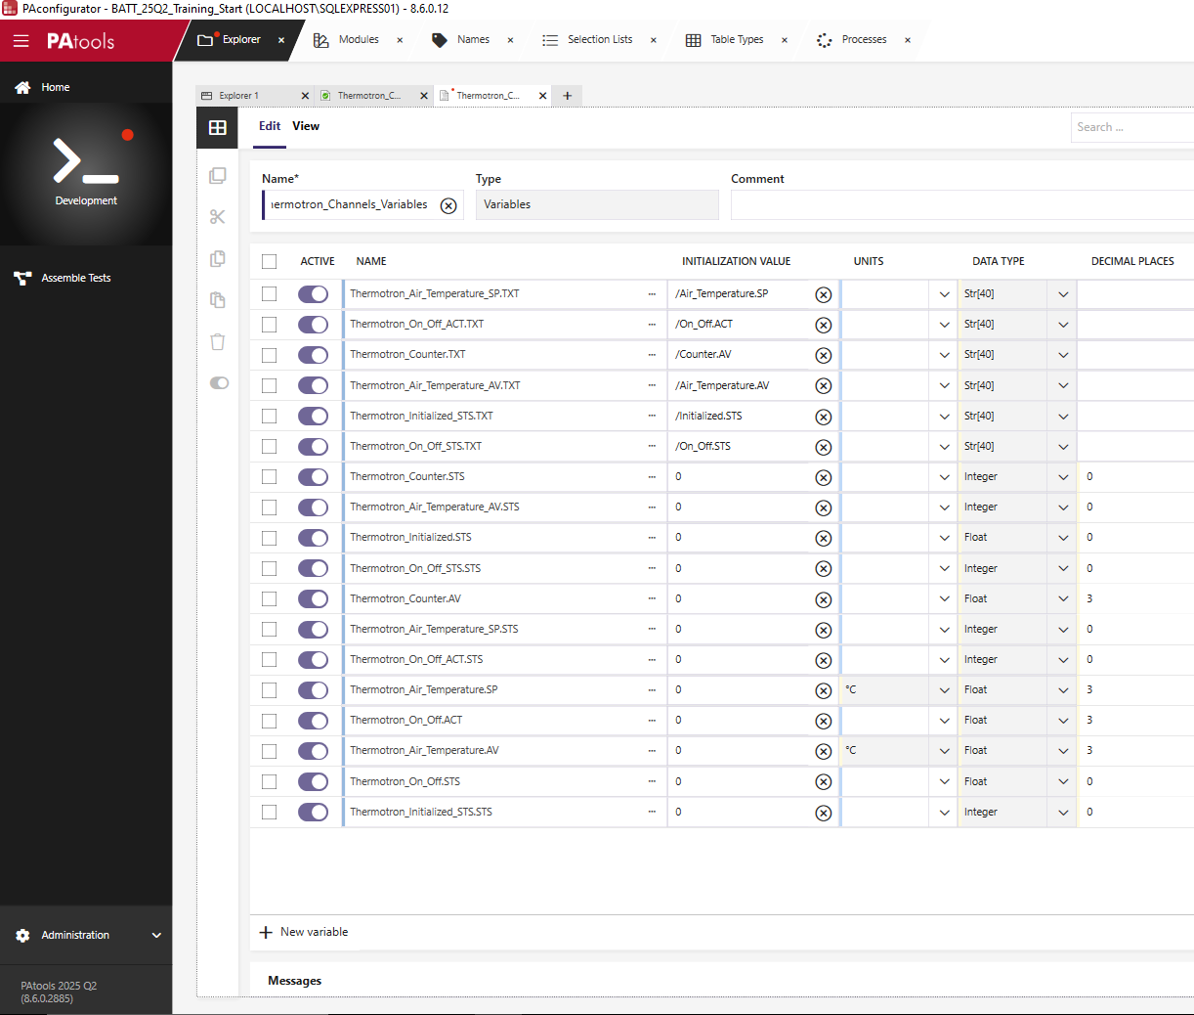
Phase 3: Define Variables in Channels Variables
Default variables are provided as an example of the various data types and format
The variables here must match the variables created from Define Data Channels in the LabVIEW project
There are three types of variables needed: PAtools variable, channel name as defined in Define Data channels, and status variable to show connection between LabVIEW and PAtools
Define the following channels (easiest to define in Edit as Excel)

Slide 44
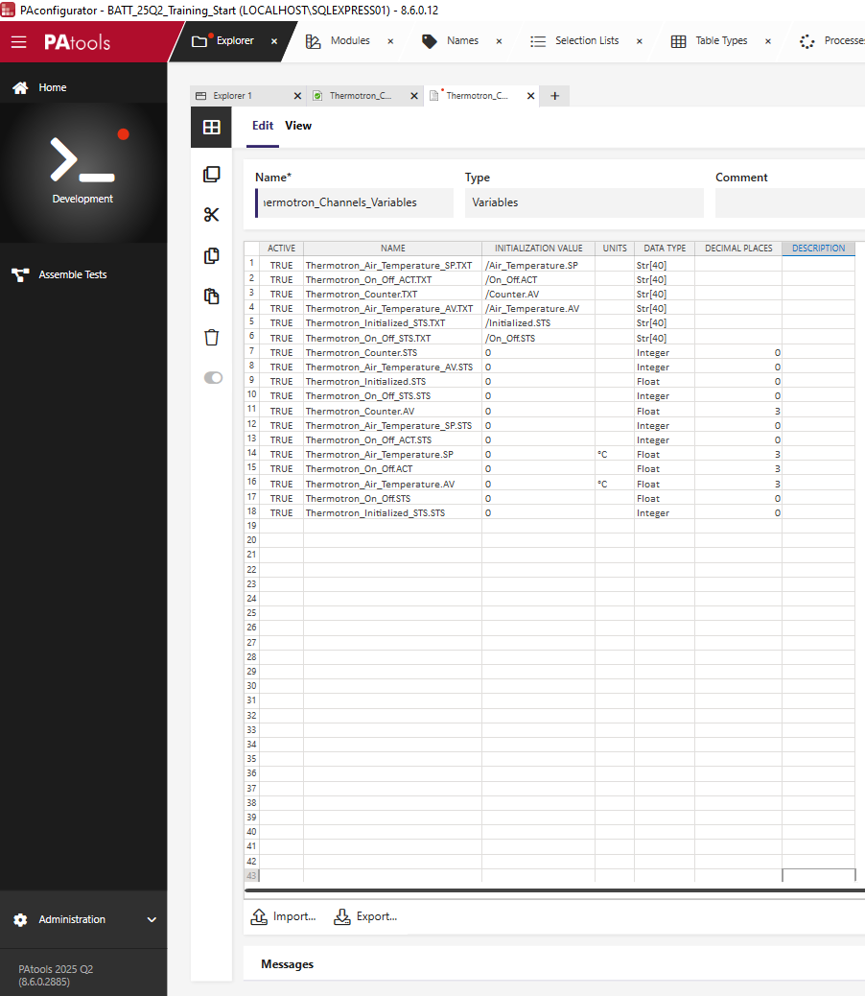
Phase 3: Define Variables in Channels Variables

Slide 45
Phase 3: Define Variables in Channels Variables

Slide 46
Phase 3: Required Variables
Three variables are needed for each channel
PAtools Variable: This is the variable used for setting setpoints and reading feedback values
Channel Name: This is a text value that defines the channel names used in the Define Data Channels VI
Status Variable: This variable defines the linkage status between the PAtools channel and the LabVIEW channel

Slide 47
Phase 3: Configure Consumer Channels

Slide 48
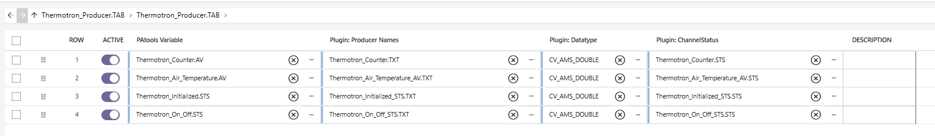
Phase 3: Configure Producer Channels

Slide 49
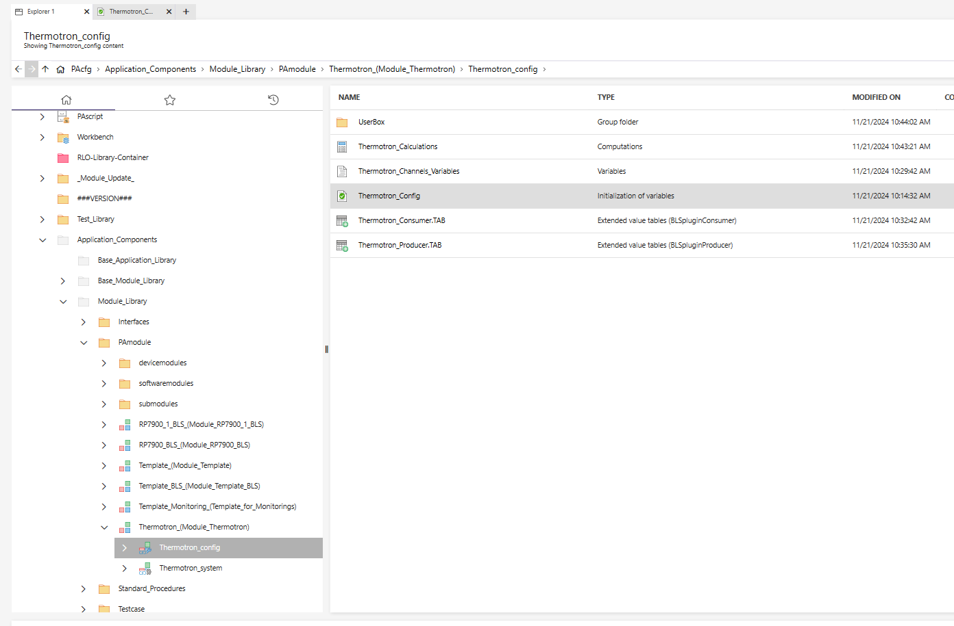
Phase 3: Configure Thermotron_Config

Slide 50
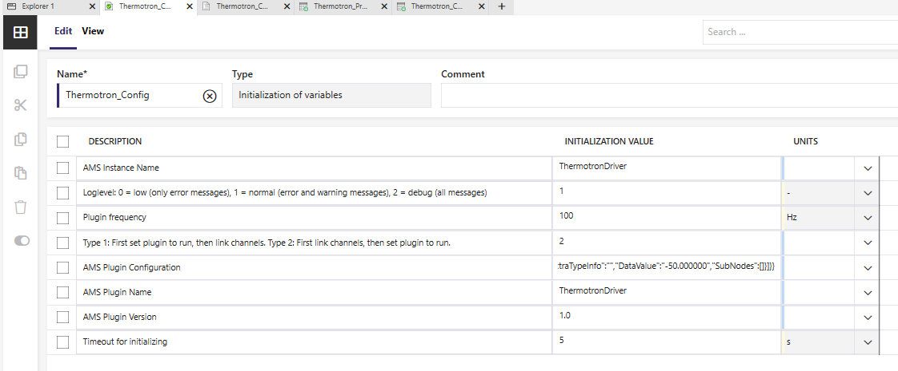
Phase 3: Configure Thermotron_Config
The instance name must be unique – no two plugins can have the same instance name
The plugin name is the name of the packed project library on the PXI
The plugin configuration is the JSON configuration string generated from the LabVIEW project

Slide 51
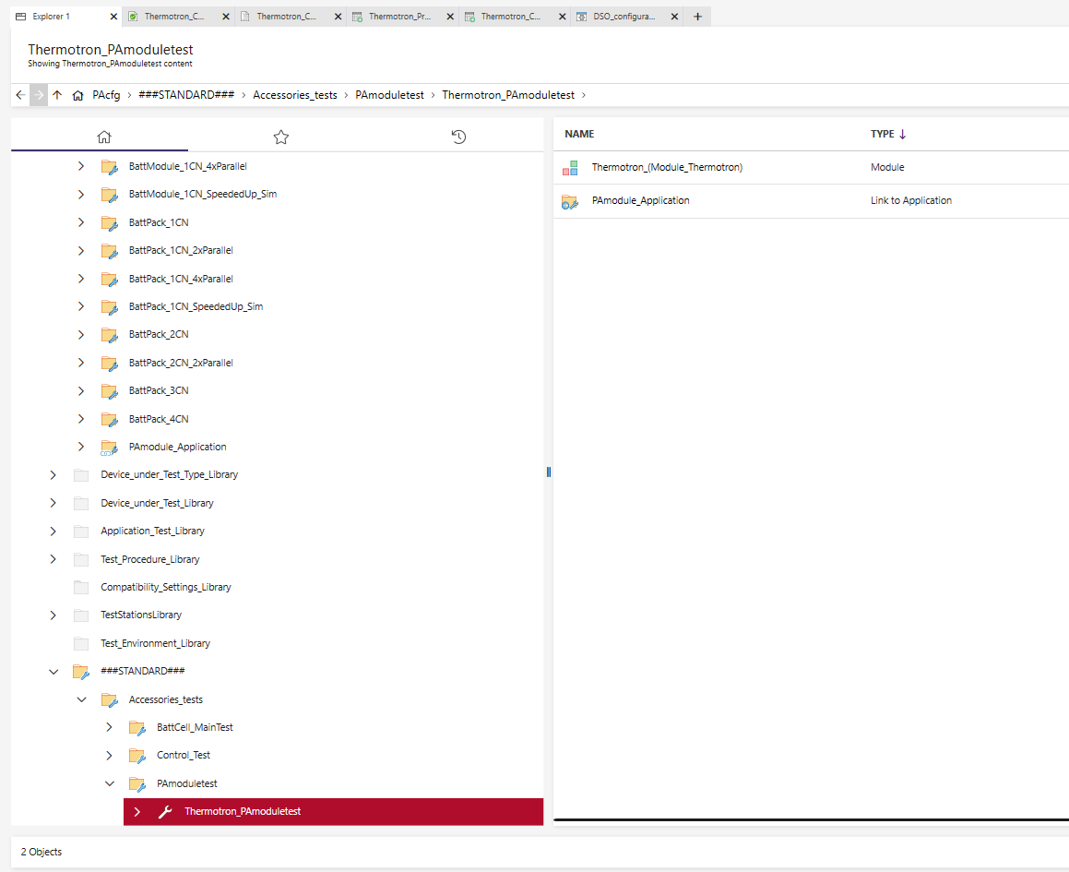
Phase 3: Send Test to Test Bench
Create a duplicate of a PAmoduleTest and add the Thermotron device module by right clicking - copy, and right click – paste link
Send test to test bench and resolve errors: Recompile PAbasic script, check calculations, update userbox (go to next slide)

Slide 52
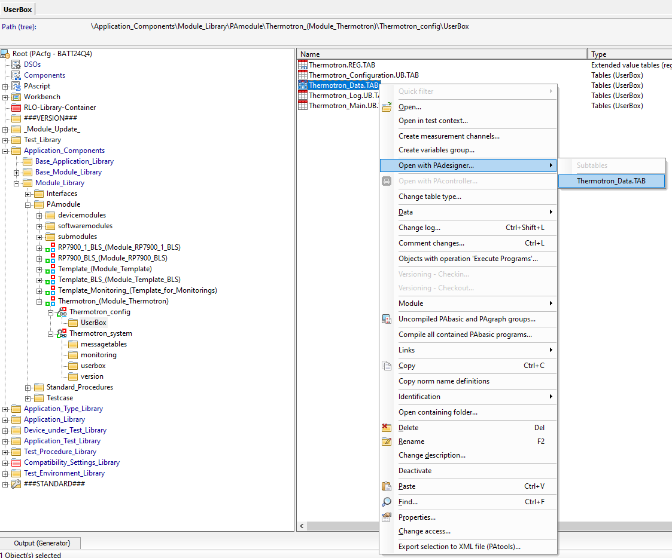
Phase 3: Update Userbox
Open Thermotron device module in PAconfigurator Classic and navigate to the userbox folder in the Thermotron_config
Right click on Thermotron_Data.TAB and select Open with PAdesigner

Slide 53
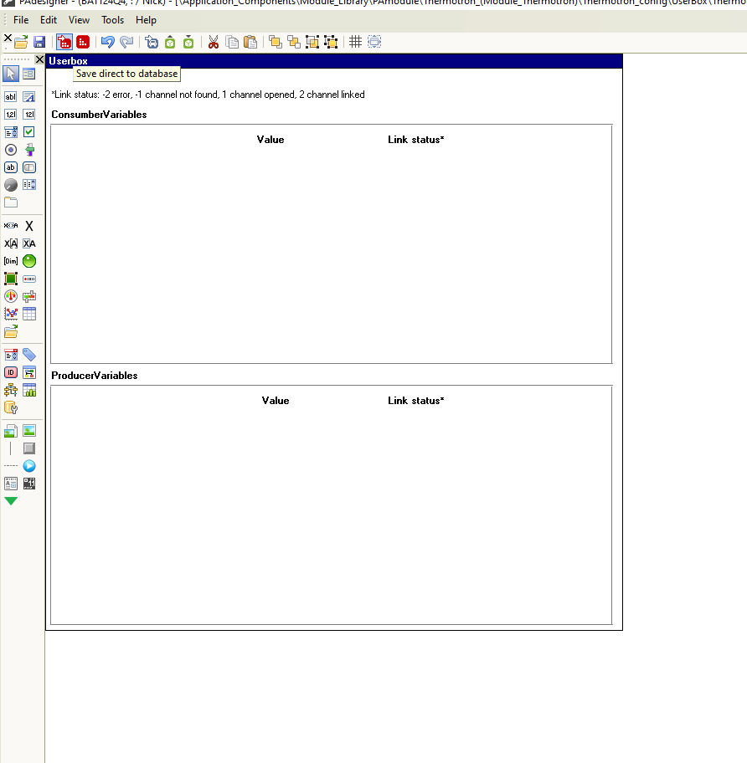
Phase 3: Update Userbox
Delete all variable UI elements

Slide 54

Phase 3: Create UserBox
The UserBox can be customized to meet specific needs and workflows
Use UI elements to build a UserBox like shown:

Slide 55

Phase 3: Saving UserBox
Select the Save Direct to Database button to save to the configuration to the UserBox table in PAconfigurator

Slide 56

Phase 3: Testing Plugin
Send the test to test bench
In PAcontroller, add a new tab
Add a Userbox from the Toolbox and select the table Thermotron_Main.UB.TAB
Click on the power button to initialize the driver
Confirm that you can start/stop chamber control, send temperature setpoints, and read temperature feedback

Slide 57


Phase 3: Testing the UserBox
You can use the Load and Save To Clipboard functionalities to quickly test UserBoxes on the fly

Slide 58


Phase 3: Testing the UserBox
Adjust the UI element sizing as needed

Slide 59

Phase 3: Updating the UserBox
Set the background color for each element to be white for consistency with other UI elements

Slide 60

Phase 3: Updating the UserBox
Test the buttons and update the value limits and increments
Save the UserBox Direct to Database and resend the test to the test bench to confirm changes applied as expected

Slide 61

Phase 3: Add Units to Norm Names
Update the norm names to include units that can be used in the UserBox
Select Names tab and search for variable
Select edit and add Units for temperature setpoint and feedback variables

Slide 62

Phase 3: Add Units to Norm Names
In the UserBox, add a dimension element for the setpoint variables

Slide 63

Phase 3: Add Error Handling
Open Message Table

Slide 64

Phase 3: Add Error Handling
Add a new line with the following message: "Thermotron Driver Error: %s. See logs for more info“
%s refers to the variable defined in Parameter 1: Thermotron_PluginError.STS
All LabVIEW errors are published on this variable. More descriptive error messages can be configured for common errors

Slide 65

Phase 3: Add Error Handling
Open Monitoring group type to configure the alarm

Slide 66

Phase 3: Add Error Handling
Add a row monitoring Thermotron_PluginError.STS, which must be 0. Any other value indicates an error.
Follow the structure for the other monitorings, and set the Message Number to 14 to match the value indicated in the Message Table

Slide 67


Phase 3: Test Error Handling
Check the error handling by running the plugin, then disconnecting the 8200 simulation

Slide 68
Phase 4: Map Device Module to Battery Application
Objective: In this phase, you will map your Thermotron device module to the Battery Application to be used in default alarms, limits, and test sequences.

Slide 69
Phase 4: Starting Point
Use the following instructions if you did not complete the previous phases:
Use the prebuilt LabVIEW plugin provided in …\thermal-chamber-pbl\Support\Phase 3 Starting Point
Refer to the JSON configuration TXT file, be sure to input the IP address of the thermal chamber in the JSON configuration string
Move the LabVIEW .lvlibp to PXI using FileZilla/WinSCP/other SFTP client: /usr/lib/x86_64-linux-gnu/ni-evo-engine/plugins
Set file permissions to 777
Reboot PXI or ssh into PXI and run the following command: enable-adas-startup.sh
This will restart the plugin engine
Note: Do not run this command while plugins are executing
Find the PAtools device module in …\thermal-chamber-pbl\Support\Phase 4 Starting Point
In PAconfigurator, import the device module to Application Components/PAmodule

Slide 70

Phase 4: Map to Battery Application
PAtools allows for mapping from the driver level to the application level, creating an easy interface to interchange hardware
The simulated modules often give a good starting point for the required mappings for variables
Open the CCSimu device module

Slide 71

Phase 4: Map to BattModule Application
Create a new module configuration in the Thermotron module called Thermotron_config_OT
Add a new folder called Thermotron_Mapping

Slide 72

Phase 4: Map to BattModule Application
The _OT (operating test) configuration is used when the climate chamber is included in the operating test and the chamber is not shared
Open the CCSimu_mapping.IN.TAB

Slide 73

Phase 4: Map to BattModule Application
Create a new Extended value tables of type Modul_Mapping for both the Inputs and Outputs
Configure the Input mapping as shown
Deactivate the humidity values since they are not implemented for this thermal chamber
Deactivate the stability check for now, this will be added later

Slide 74

Phase 4: Map to BattModule Application
Open the CCSimu output mapping and observe the signals being mapped
Replicate this structure as shown in the Thermotron Output Mapping

Slide 75

Phase 4: Map to BattModule Application
Next, the mapping execution and timing must be defined
In the CCSimu device module, this can be found in the Module System as CCSimu_mapping.IN.P, CCSimu_mapping.OUT.P, and CCSimu_MEH.A

Slide 76

Phase 4: Map to BattModule Application
In the Thermotron_Mapping folder, create the following group types:
PAbasic: Thermotron_mapping.IN.P and Thermotron_mapping.OUT.P
Operation Table: Thermotron_MEH.A

Slide 77

Phase 4: Map to BattModule Application
Open the PAbasic scripts and replicate the mappings shown in the CCSimu device module

Slide 78

Phase 4: Map to BattModule Application
Configure the Operation Table to execute these mapping tables
Refer to the CCSimu_MEH.A operation table as a guide
Use SeqCtrl_operating_mode.CTL == SeqCtrl_CV_operating_mode_automatic_mode as the condition for the input mapping to allow for manual mode control when test sequence is not executing

Slide 79

Phase 4: Map to BattModule Application
Remember to set the Operation Group and Priority in for the Operation Table:

Slide 80

Phase 4: Map to BattModule Application
Now that mappings are added, replace the CCSimu device module with the Thermotron device module
Create a new Application Configuration to accommodate this new hardware:

Slide 81

Phase 4: Map to BattModule Application
Delete the CCSimu device module from the Application Configuration

Slide 82

Phase 4: Map to BattModule Application
Copy and paste link the Thermotron device module, using the OT module configuration

Slide 83

Phase 4: Map to BattModule Application
Create a new test called Thermotron_OT and send to test bench
Use BattModule application and and simulated DUT

Slide 84
Phase 4: Map to BattModule Application
After deploying and starting chamber control, confirm that Thermotron_Air_Temperature.AV matches CCsub_Temperature.AV
The input mappings won’t be active until the operating test is in automatic mode

Slide 85

Phase 4: Map to BattModule Application
Update the Workspace for the Thermotron configuration
In PAcontroller, update the userbox in the CC tab to use Thermotron_Main.UB.TAB

Slide 86

Phase 4: Map to BattModule Application
In PAconfigurator, create a new Workspace called BattModule-Test_CC_in_OT_Thermotron under the Workbench folder
This will create a unique UI layout specifically for the Thermotron configuration

Slide 87


Phase 4: Map to BattModule Application
In PAcontroller, select Workspace => Save to database, and select the newly created workspace

Slide 88

Phase 4: Map to BattModule Application
Open the _Thermotron_Simu_1CN_WCU_CC_OT Application Configuration and open the Workspace initialization group type
Change the initialization value to newly created Thermotron workspace
Resend the test to the test station and confirm that the changes applied

Slide 89

Phase 4: Map to BattModule Application
Test the automatic mode functionality by configuring a BattModule test sequence with a basic temperature setpoint
Create a copy of the _Template_BattModule procedure and name it _Thermotron_Test_BattModule
Configure the CustomerTest.SEQ with a single climate chamber step

Slide 90
Phase 4: Additional Challenges
Challenges:
To avoid unexpected manual control during a test sequence, it is best practice to add a condition to the thermal chamber inputs. Configure the inputs in the Userbox to be disabled if a test sequence is active.
Add check for stability functionality from the CCsimu device module

